Slide 1

PES’s Modern College of Engineering, Shivajinagar, Pune-5. Department of Electronics and Telecommunication A.Y. – 2021-22
Project Group ID- A8
Dry/ Wet Garbage Segregation and Monitoring
1. Omkar Bhilare -32006
2. Rishikesh Datey -32016
3. Neha Ghogare - 32030
Mini-Project Coordinators
Dr. Mrs. V. P. Kodgirwar
Dr. Mrs. K. A. Adoni
Mr. Ramgopal Sahu

Slide 2
Introduction
This work is concerned with the issues of Municipal solid waste management in India with Emphasis on problems related to disposed by landfills.
Today’s era its big problem to consume waste. Day by day all types garbage increasing very fast and its harmful to human’s and societies.
The main importance is to separation of garbage in Wet and Dry category. This project we made a smart garbage box for this speration auto.

Slide 3
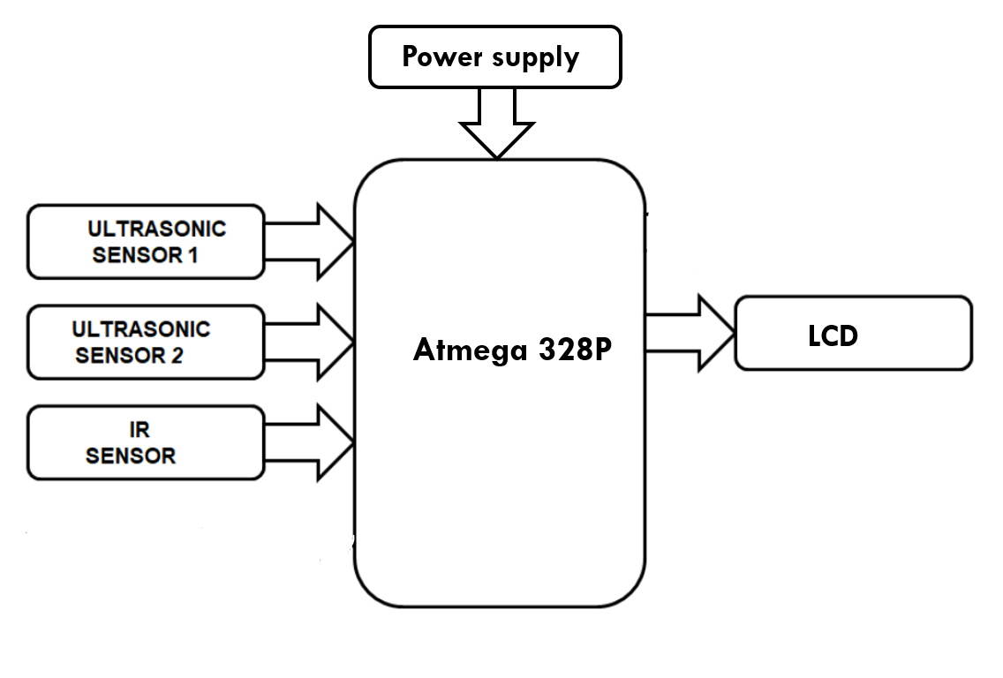
Block Diagram

Slide 4
Working of project
When the object (waste) is placed on the plank one by one IR sensor detects the object.
Depending upon the type of object(wet /dry) placed on the plank, moisture sensor detects whether the object is wet or dry.
If the object contains moisture then servo motor send object into the Left Chamber.
If the object does not contains any moisture then servo motor send object into the Right Chamber.
Ultrasonic sensor is use to measure the junk level of both the chamber.
LCD display will show the remaining space in Chamber (in %) and count of objects put in both the chamber.

Slide 5
Applications
It can be used for collecting the garbage from public palces, household, etc
Reducing human time and effort which requires to segregate garbage.
Municipal Corporation can use it as replacement to the traditional dustbins.

